Slide 1
Immutable Infrastructures in SQA
BYUNG KANG / ROBBY LAGEN

Slide 2
Immutable Infrastructures?

Slide 3
Immutable Infrastructures?

Slide 4
Immutable Infrastructures?

Slide 5
Immutable Infrastructures?

Slide 6
Immutable Infrastructures?

Slide 7
“Immutable infrastructure is an approach to managing services and software deployments on IT resources wherein components are replaced rather than changed. An application or service is effectively redeployed each time any change occurs.”
Margaret Rouse

Slide 8
Destroy and recreate the entire infrastructure after an IT-related update.

Slide 9
youtube video downloader

Slide 10
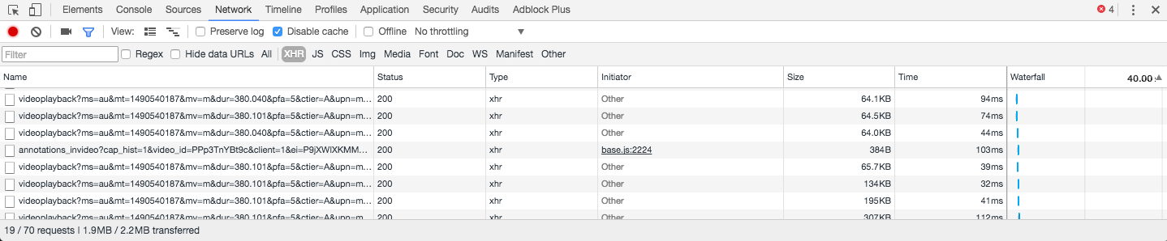
youtube video downloader

Slide 11
Video -> Audio

Slide 12
Video -> Audio
“It works on my machine”

Slide 13
config

Slide 14
config
DEV

Slide 15
config
DEV
QA

Slide 16
config
DEV
QA
OPS

Slide 17
Why should we use it?
It works on my machine.

Slide 18
Why should we use it?
It works on my machine.

